Slide 1
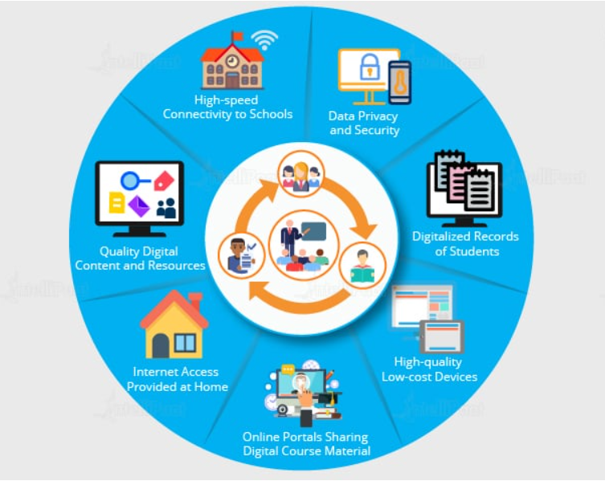
Big Data in Education Industry
Education industry is flooding with huge amounts of data related to students, faculty, courses, results, and what not. Now, we have realized that proper study and analysis of this data can provide insights which can be used to improve the operational effectiveness and working of educational institutes.

Slide 2
Following are some of the fields in the education industry that have been transformed by big data-motivated changes:
Customized and Dynamic Learning Programs
Customized programs and schemes to benefit individual students can be created using the data collected on the bases of each student’s learning history. This improves the overall student results.
Reframing Course Material
Reframing the course material according to the data that is collected on the basis of what a student learns and to what extent by real-time monitoring of the components of a course is beneficial for the students.
Grading Systems
New advancements in grading systems have been introduced as a result of a proper analysis of student data

Slide 3
Career Prediction
Appropriate analysis and study of every student’s records will help understand each student’s progress, strengths, weaknesses, interests, and more. It would also help in determining which career would be the most suitable for the student in future.
The applications of big data have provided a solution to one of the biggest pitfalls in the education system, that is, the one-size-fits-all fashion of academic set-up, by contributing in e-learning solutions.
Example
The University of Alabama has more than 38,000 students and an ocean of data. In the past when there were no real solutions to analyze that much of data, some of them seemed useless. Now, administrators are able to use analytics and data visualizations for this data to draw out patterns of students revolutionizing the university’s operations, recruitment, and retention efforts.

Slide 4
The Top Big Data Challenges in Education
Integration across institutional boundaries – K-12 schools are generally organized around academic disciplines. Universities are organized as separate schools, faculties, and departments. Each of these units operates somewhat independently of the others and share real estate as a matter of convenience. Integrating data across these organizational boundaries is going to be a major challenge. No organizational unit is going to surrender any part of its power base easily. Data is power.
Self-service analytics and data visualization -- It is going to be a piece of cake to give planners and decision makers the technology based tools they need to do their own analytics and visualize the results of their studies graphically. It is going to be a genuine challenge to create a culture that requires them to do their own studies using those tools. An even greater challenge will be to create a climate that informs their decision making with the results of their own studies because they are so accustomed to making decisions intuitively.
Privacy – There is a great deal of concern – perhaps even excessive concern – about the privacy of the information collected about each student and her family. The concern is that this data could fall into the wrong hands or be abused by those who have been given responsibility for safeguarding the information. To some extent, this is a technological and management issue. However, the fundamental issue is fear that the technical and management safeguards either won’t work or will be abused. Lisa Shaw, a parent in the New York City public school system said, “It’s really invasive. There’s no amount of monetary funds that could replace personal information that could be used to hurt or harm our children in the future.”

Slide 5
Correlation vs ‘cause and effect’ – Purists in rational argument want to see arguments that clearly spell out cause-and-effect relationships before blessing them as a basis for decision making. The fact that two factors may be highly correlated does not satisfy this demand for cause-and-effect. Nevertheless, real world experience in other areas of Big Data have shown that high correlations are sufficient by themselves to make decisions that are either lucrative or achieve the objectives the players in mind. This means they have been able to realize significant benefits based on correlation without being able to argue the underlying mechanics.
Money – Nearly all educational institutions are strapped for money. When they make decisions to invest in the hardware, software, staff, and training to exploit Big Data, they are making decisions not to hire another professor, equip a student lab, or expand an existing building. That can be a tough call.
Numbers game – Some argue – perhaps rightfully so – that Big Data reduces interactions with students to a numbers game. Recommendations and assessments are based entirely on analytics. This means that compassion, personal bonding, and an understanding of the unique circumstances of every student gets lost in the mix. Others argue that Big Data is an assist to the human process. In any event, this is unquestionably a stumbling block.

Slide 6
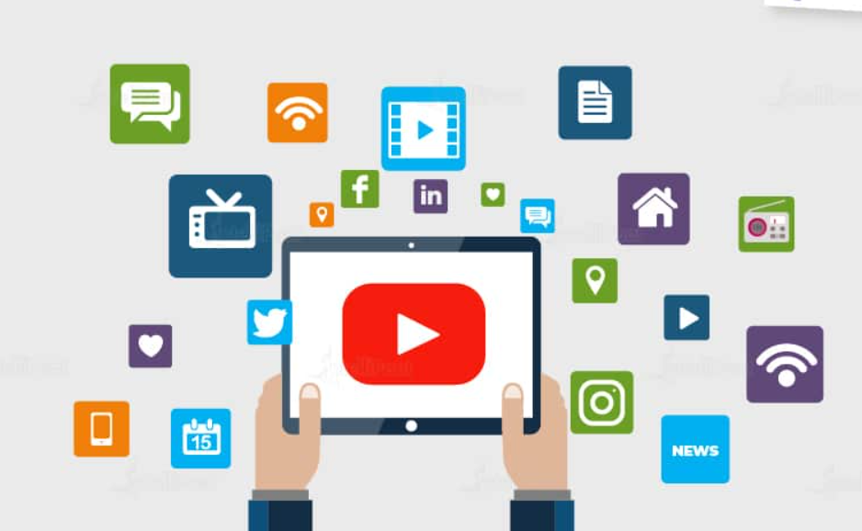
Big Data in Media and Entertainment Industry
With people having access to various digital gadgets, generation of large amount of data is inevitable and this is the main cause of the rise in big data in media and entertainment industry.
Other than this, social media platforms are another way in which huge amount of data is being generated. Although, businesses in the media and entertainment industry have realized the importance of this data, and they have been able to benefit from it for their growth.

Slide 7
Some of the benefits extracted from big data in the media and entertainment industry are given below:
Some of the benefits extracted from big data in the media and entertainment industry are given below:
Predicting the interests of audiences
Optimized or on-demand scheduling of media streams in digital media distribution platforms
Getting insights from customer reviews
Effective targeting of the advertisements
How big data is used in media and entertainment
Analyzing big data is crucial to generating more revenue and providing personalized experiences in this digitally-driven industry. Here are a few ways big data is being applied in media and entertainment today:
Companies like Hulu and Netflix work with an abundance of big data daily to analyze user tendencies, preferred content, trends in consumption, and much more. As a matter of fact, Netflix used predictive data analysis to craft its show House of Cards since the data validated that it’d be a hit with consumers.
Ever wonder why so many streaming services are coming out? That’s because big data is unveiling new ways to monetize digital content, creating new revenue sources for media and entertainment companies.
Ads are targeted more strategically thanks to big data analytics software, helping companies understand the performance of ads more clearly based on certain types of consumers.

Slide 8
Example
Spotify, an on-demand music providing platform, uses Big Data Analytics, collects data from all its users around the globe, and then uses the analyzed data to give informed music recommendations and suggestions to every individual user.
Amazon Prime that offers, videos, music, and Kindle books in a one-stop shop is also big on using big data.

Slide 9
What are the challenges that the film industry will face arising from it using big data analytics?
1. Need for Talent/Staff
When a film company wants to use big data analytics, it needs to hire experts. Nowadays, data analytics experts are one of the most highly paid professionals in the software world.
Hiring an expert costs a lot. This is why moviemakers will likely turn to big data analytic movie companies like Largo Films to save money.
2. Data Quality Issue
The data quality issue is a huge potential disadvantage of big data analytics. Companies need to make sure that the data they are using is reliable and in the correct format for data analysis and interpretation.
Bad data should be considered worthless and could be very costly businesses.
3. Individual Privacy
Privacy is one of the biggest concerns of companies in relation to big data analytics. Companies are required to make sure that they comply with government regulations regarding data and information gathering.
If they are storing personal and sensitive information of the users, movie companies should ensure that the storage and handling of this information adhere to all the necessary laws and regulations imposed by the government to protect the right of privacy of its people.

Slide 10
Challenges of Data Analytics and How to Fix Them
However, achieving these benefits is easier said than done. There are several challenges that can impede risk managers’ ability to collect and use analytics. Fortunately, there’s a solution:
Collecting meaningful and real-time data
With so much data available, it’s difficult to dig down and access the insights that are needed most. When employees are overwhelmed, they may not fully analyze data or only focus on the measures that are easiest to collect instead of those that truly add value. In addition, if an employee has to manually sift through data, it can be impossible to gain real-time insights on what is currently happening. Outdated data can have significant negative impacts on decision-making.
A data system that collects, organizes and automatically alerts users of trends will help solve this issue. Employees can input their goals and easily create a report that provides the answers to their most important questions. With real-time reports and alerts, decision-makers can be confident they are basing any choices on complete and accurate information.

Slide 11
Lack of support
Data analytics can’t be effective without organizational support, both from the top and lower-level employees. Risk managers will be powerless in many pursuits if executives don’t give them the ability to act. Other employees play a key role as well: if they do not submit data for analysis or their systems are inaccessible to the risk manager, it will be hard to create any actionable information.
Emphasize the value of risk management and analysis to all aspects of the organization to get past this challenge. Once other members of the team understand the benefits, they’re more likely to cooperate. Implementing change can be difficult, but using a centralized data analysis system allows risk managers to easily communicate results and effectively achieve buy-in from multiple stakeholders.
Poor quality data
Nothing is more harmful to data analytics than inaccurate data. Without good input, output will be unreliable. A key cause of inaccurate data is manual errors made during data entry. This can lead to significant negative consequences if the analysis is used to influence decisions. Another issue is asymmetrical data: when information in one system does not reflect the changes made in another system, leaving it outdated.
A centralized system eliminates these issues. Data can be input automatically with mandatory or drop-down fields, leaving little room for human error. System integrations ensure that a change in one area is instantly reflected across the board.

Slide 12
Limitations In Big Data Analytics
However, although big data analytics is a remarkable tool that can help with business decisions, it does have its limitations.
Prioritizing correlations
Data analysts use big data to tease out correlation: when one variable is linked to another. However, not all these correlations are substantial or meaningful. More specifically, just because 2 variables are correlated or linked doesn’t mean that a causative relationship exists between them (i.e.,“correlation does not imply causation”). For instance, between 2000 and 2009, the number of divorces in the U.S. state of Maine and the per capita consumption of margarine both similarly decreased. However, margarine and divorce have little to do with each other. A good consultant will help you figure out which correlations mean something to your business and which correlations mean little to your business.

Slide 13
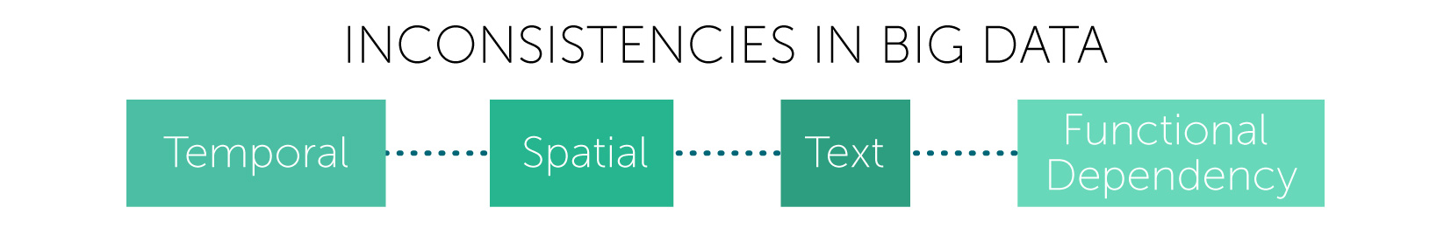
Inconsistency in data collection
Sometimes the tools we use to gather big data sets are imprecise. For example, Google is famous for its tweaks and updates that change the search experience in countless ways; the results of a search on one day will likely be different from those on another day. If you were using Google search to generate data sets, and these data sets changed often, then the correlations you derive would change, too.
Ultimately, you need to know how to use big data to your advantage in order for it to be useful. The use of big data analytics is akin to using any other complex and powerful tool. For instance, an electron microscope is a powerful tool, too, but it’s useless if you know little about how it works.

